Slide 1


<h1>asdf</a>The powerful LibreOffice-based online office suite that supports all major document, spreadsheet and presentation file formats
Created by Collabora, the driving force behind putting LibreOffice in the Cloud

Slide 2
<h1>asdf</a>The powerful LibreOffice-based online office suite that supports all major document, spreadsheet and presentation file formats
Created by Collabora, the driving force behind putting LibreOffice in the Cloud

Slide 3

Features 1/2:
Basic Editing
Document Support:
  DOC, DOCX, PPT, PPTX, XLS, XLSX + ODF
  Import/View Visio, Publisher, + 100 more
High fidelity, WYSIWYG rendering

Slide 4
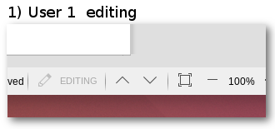
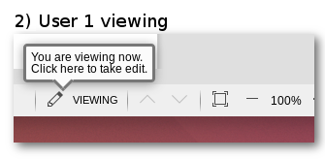
Features 2/2:
Shared editing feature:
  One user edits, others can follow,
  edit lock can be taken over
  Bla
  Now Lukas is editing
  My turn my turn!!!! ;-)
  But mine is in another color! :-)

Slide 5
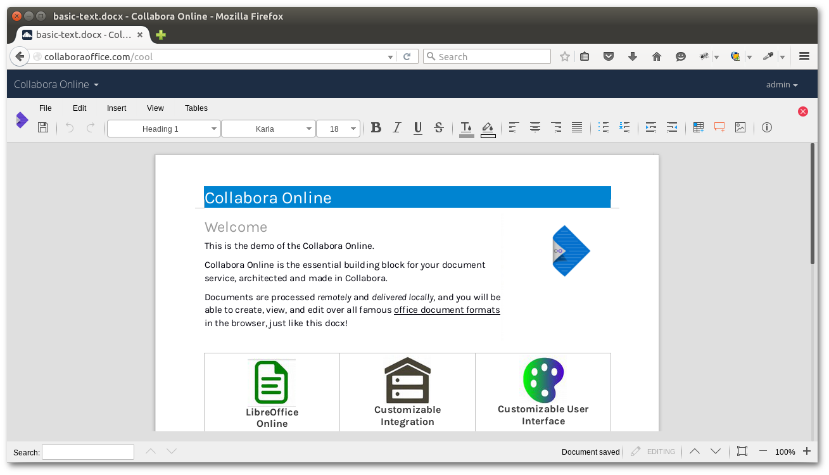
Writer:

Slide 6
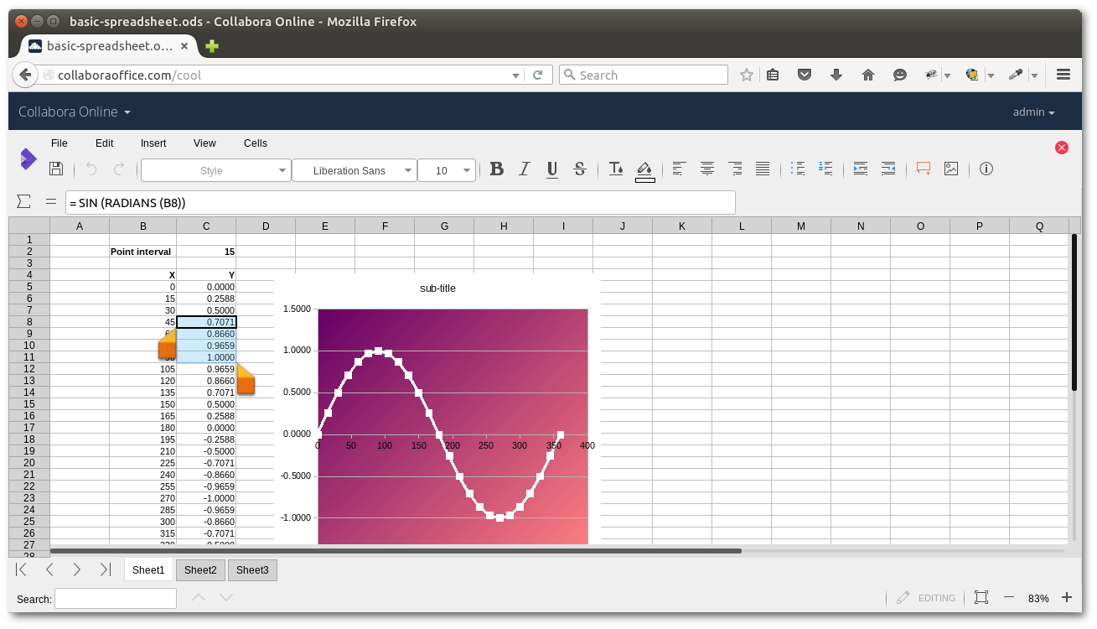
Calc:
1

Slide 7
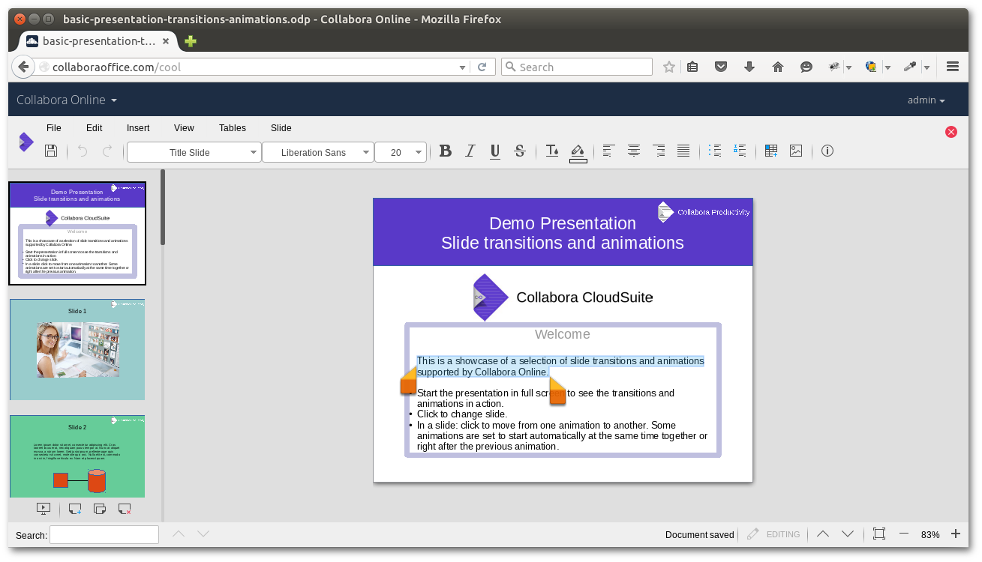
Impress:

Slide 8

Benefits:
Stable – QA’d and tested
Long Term Support – 3 years from release
Signed security updates
SLA – Guaranteed response times
Roadmap – Product management interaction and input into roadmap
Maintenance – Fixes and feature improvements over lifetime
Signed – Collabora stands behind it

Slide 9
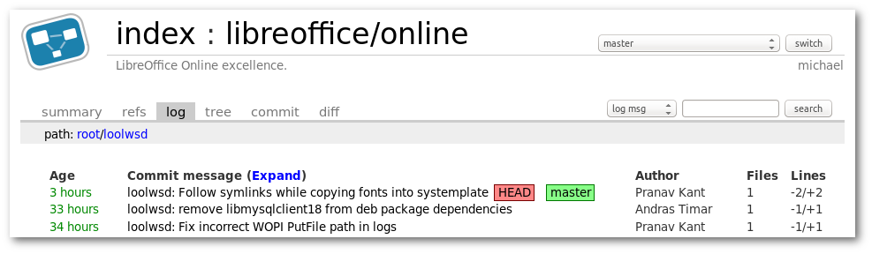
Secure:
Full control of sensitive corporate data, unlike Office 365 & Google Docs
Open Source
Security updates

Slide 10
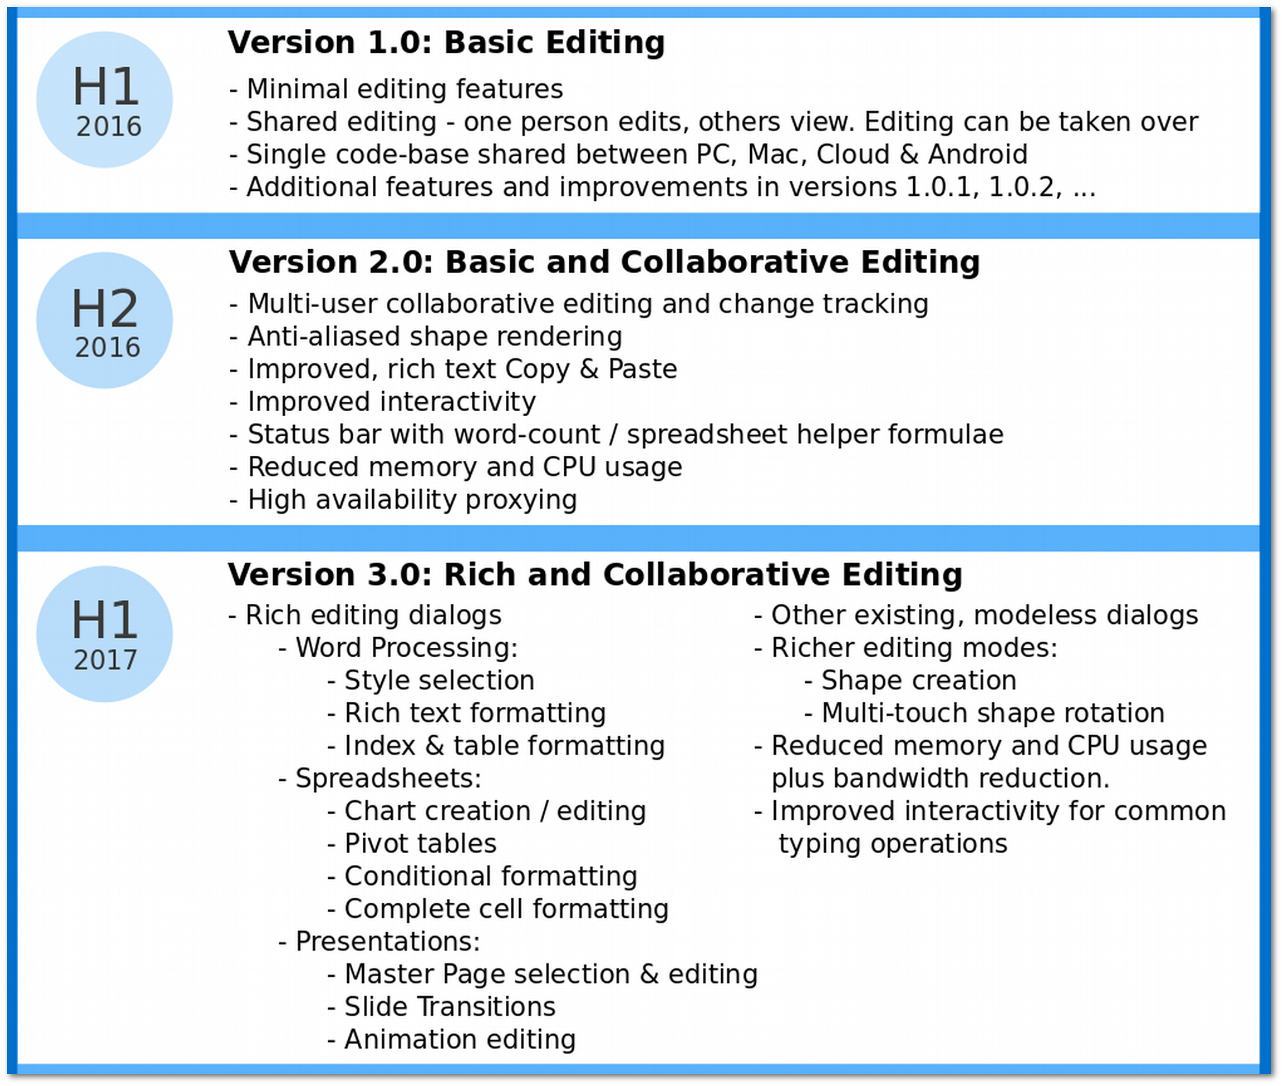
Roadmap (customer confidential):
This roadmap is subject to change

Slide 11
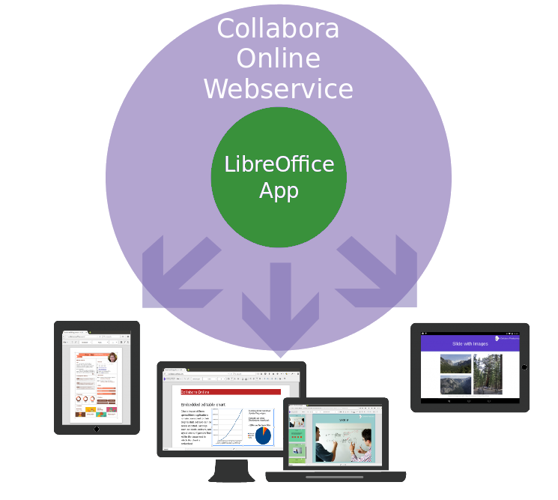
Technology:

Slide 12
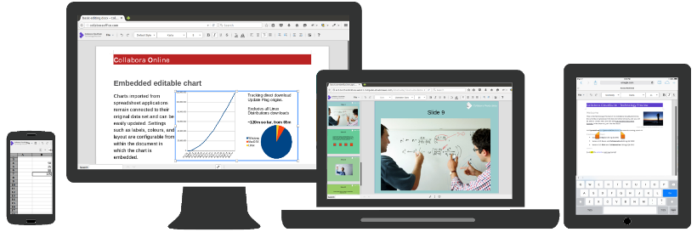
Getting started:
Contact, install, activate? ← Depends on partner
Works in all modern browsers

